Slide 1
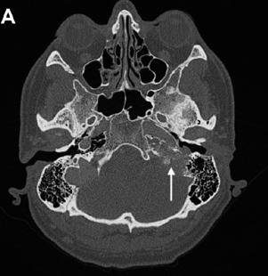
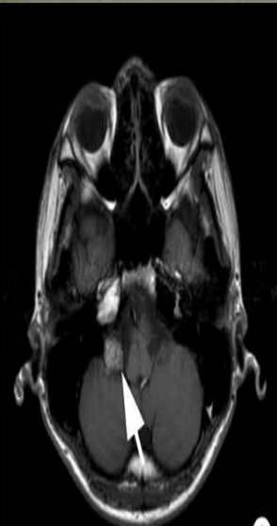
Question
A pt present in opd with complaints of decreased hearing , hearing pulsations in the ear with episodes of ear bleed with aural fullness & facial weakness . Otoscopic examination shows bulging TM with rising sun appearance . What is the classification system used for this disease .

